Slide 1
Kick-off exam Project

Slide 2

Role of supervisors
Remember: the project is not better if you have not used your supervisors.
By that I do not mean that you cannot produce quality on your own. I mean that we do not view it as a better project if you have not needed help. Also, we do not devalue solutions we have helped create….

Slide 3
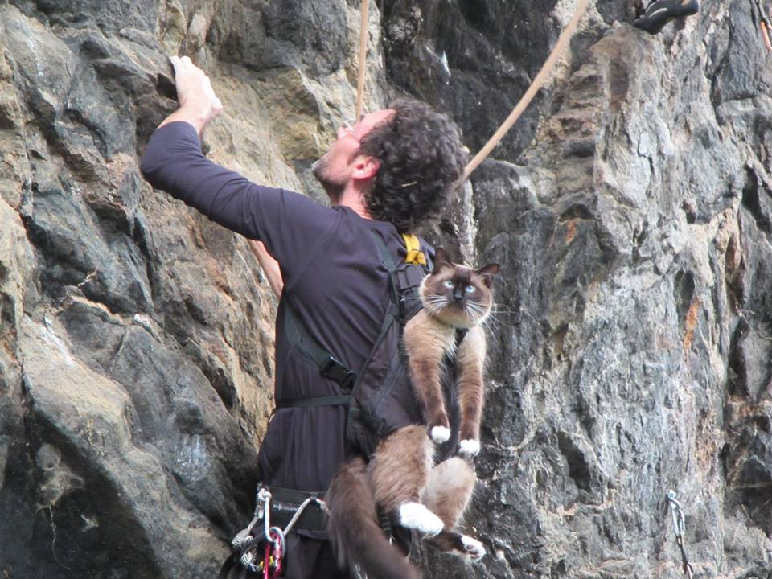
Introduction: (The project assignment’s why?)
Why is this project interesting?
general, multimedia or personal angle
Example: game for kids about environment
General angle: how to protect environment
Multimedia angle: how can we use a multimedia tool (game) to convey message; or can games change behavior
Personal angle: I think it is important that kids learn about the environment; or every day I find garbage at the beach – what can I do…
Never, never, never: I am writing this because I have to!!
Notes:
Never, never, never: I am writing this because I have to!!

Slide 4

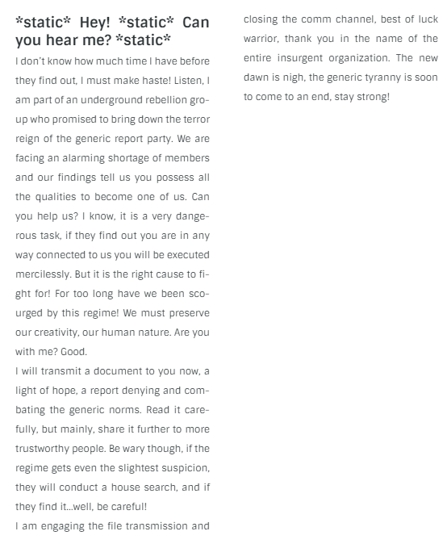
This certainly got my attention:

Slide 5
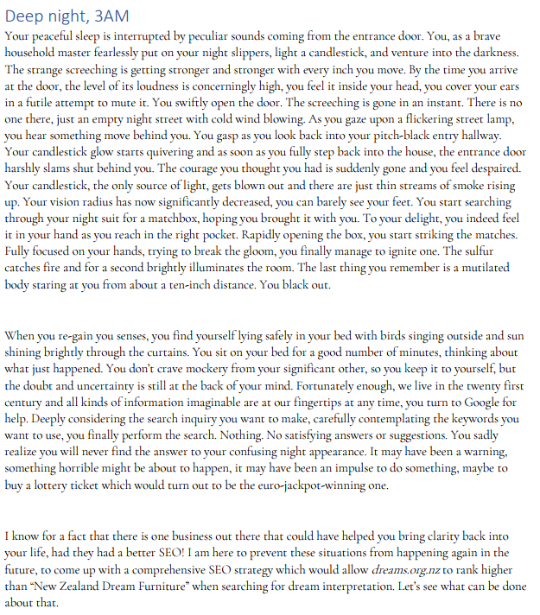
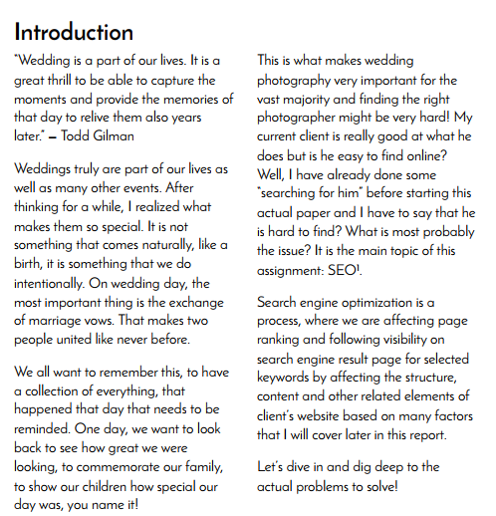
Examples

Slide 6
Problem description/ problemstilling
This is optional. This is usually used to connect introduction and problem statement. It is more specific with regards to client and problem than the introduction.
Introduction: How can SoMe be used for small companies to cost-effectively create awarenss about a new product (Multimedia angle)
Problem description: Company X is launching a new product, and they have a small budget, but they do have a substantial following on social media.
Problem statement: How can we create a social media campaign for Company X that will generate awareness about Product Y before launching the product.

Slide 7
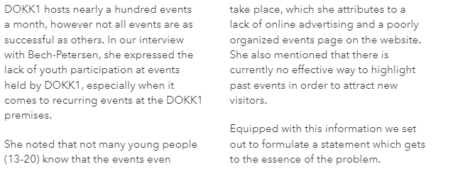
example

Slide 8

The problem statement: (The project assignment’s what?)
The problem statement can consists of 1 questions . It can be ties to several subquestions in a logical order – all questions must be answered in your conclusion.
How can storytelling be used in online marketing for IKEA
The problem statement can also be a phenomenon that you wish to discuss or a hypothesis that your wish to argue in favour of.
Based on an analysis of Ikea’s values and marketing strategy, we will analyze how IKEA can use storytelling in its online marketing.”

Slide 9
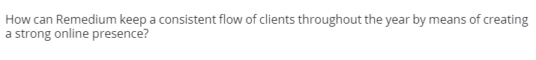

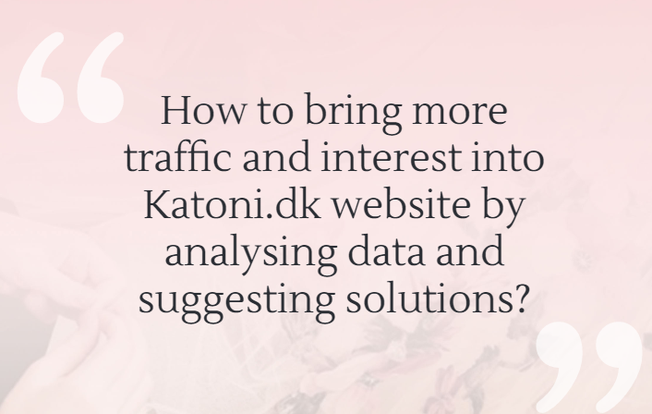

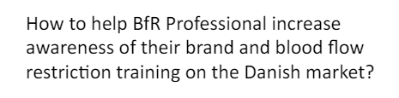
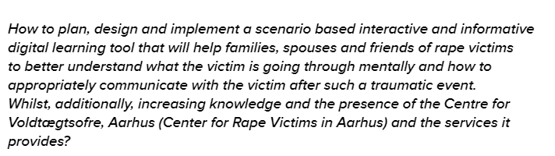
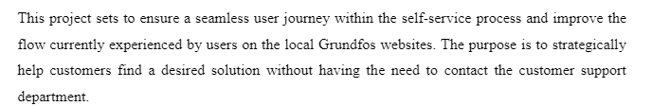
Examples

Slide 10
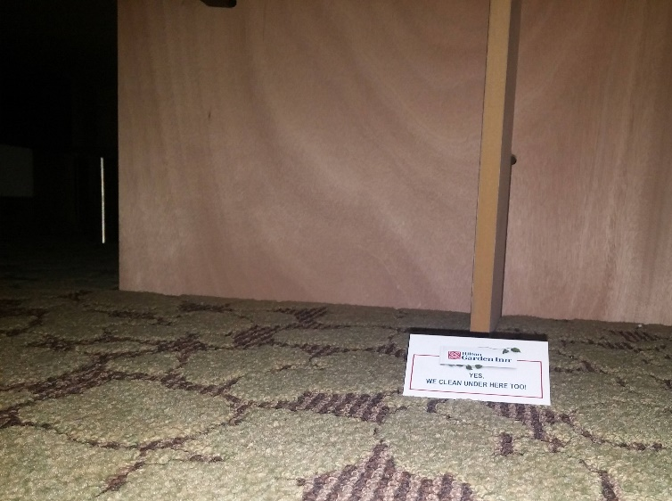

Problem delimitation: (afgrænsning)
In the example above, the project could be delimited to looking at Ikea Danmark . The delimitation would then say: “due to time constraints and limited access to data outside of the Danish market, this report will focus solely on Ikea Denmark”
Put it here if you don’t want your teachers to blame you for not including it! Yes, we check under the bed too…
Notes:
Fx: if you want to avoid us thinking that you should have included something, a specific analysis, quantitative research or whatever, in this section you state that you did not include it and why. Reasons could be: did not have access to the information (fx the company would not share it), out of scope of the assignment, time or money constraints

Slide 11
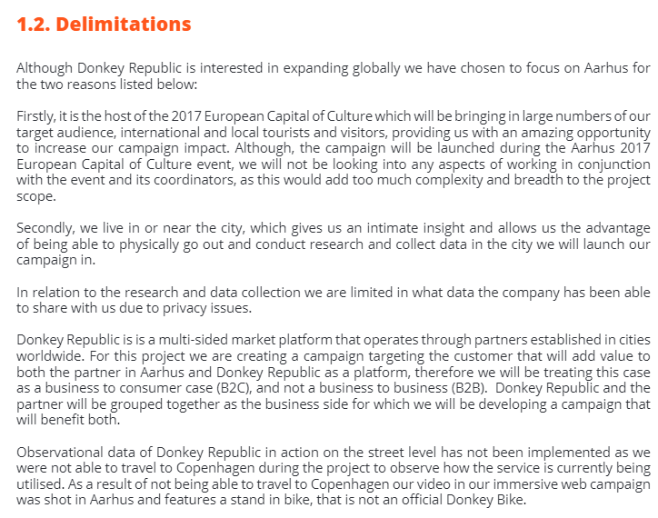
Example delimitation

Slide 12
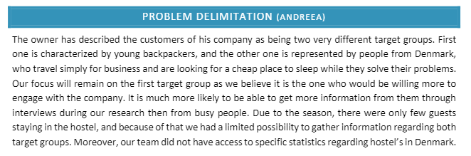
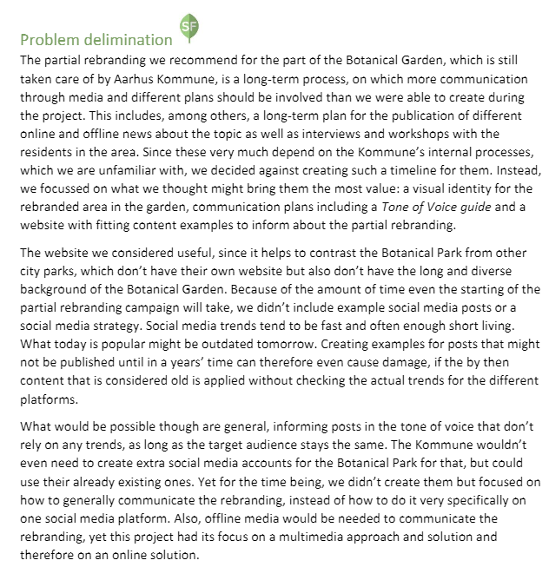
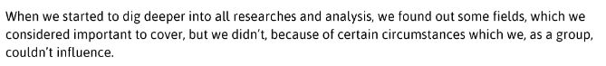
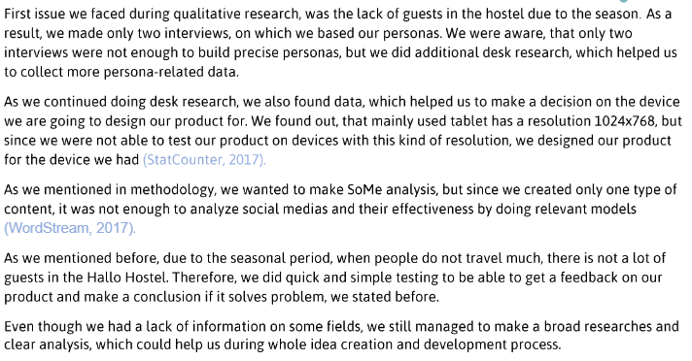
Examples delimitation
Ideally this is written before you do the project, not after

Slide 13
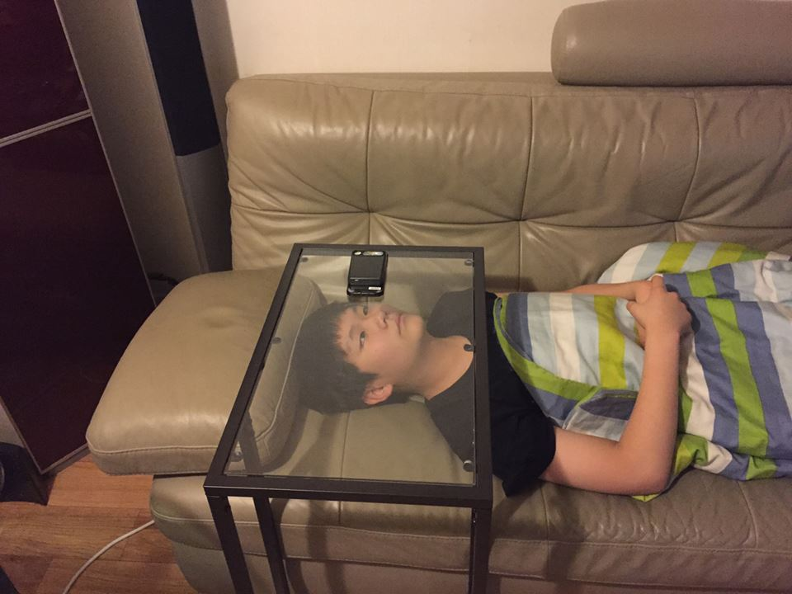
Methodology: (The project assignment’s how?)
how you intend to answer the problem
. E.g. the sources or authors you are going to use in your analysis,
how you intend to collect data/knowledge,
e.g. interviews, questionnaires, written sources, and finally,
Detailed description of i.e. how you will do interviews, where, how many participants, how you will reach participants etc.
how you intend to analyse or use your data in the problem solving
Remember to include methodology for production and test!
Pros and cons of your methods.
The simplest way of doing this is making a specific list of all tasks and then decide how
You do this before you start writing/ analysing!!
Notes:
List of task should be detailed and could include elements such as analysis of company values, target group segmentation etc.

Slide 14
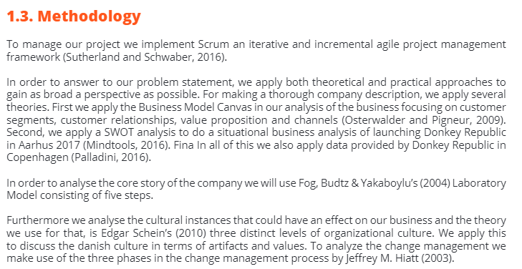
Example methodology
Please note: we write this before we do the work. That means we write this in future tense:
”We will…”
Not ” we did”

Slide 15
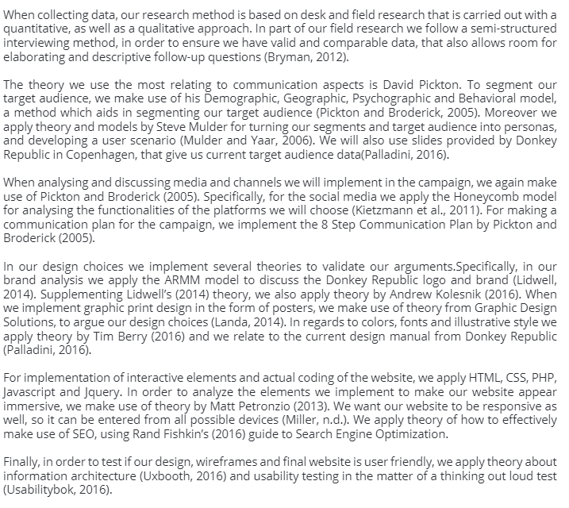
Methodology continued
Only point of critisism for this example:
Much more detail can be included about data collection, like how will participants be contacted, where will interviews take place, how will answers be recorded etc

Slide 16
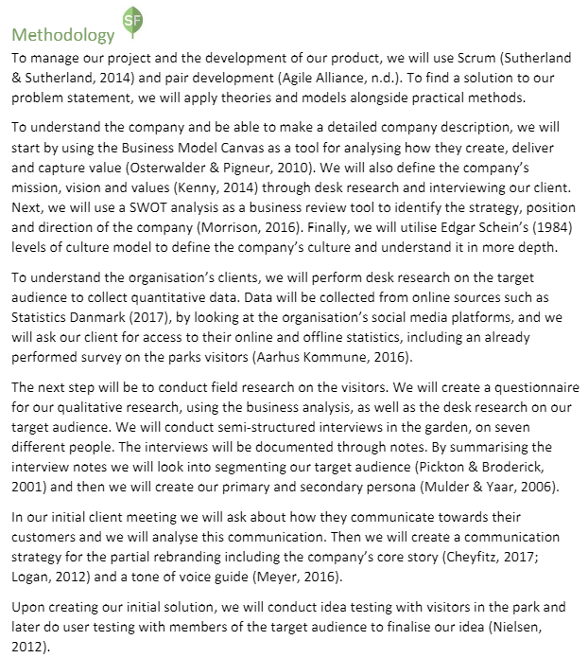
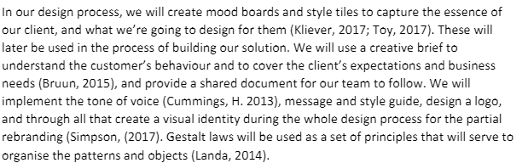
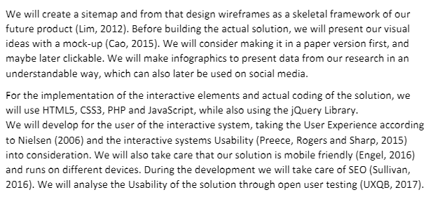
Another example methodology

Slide 17
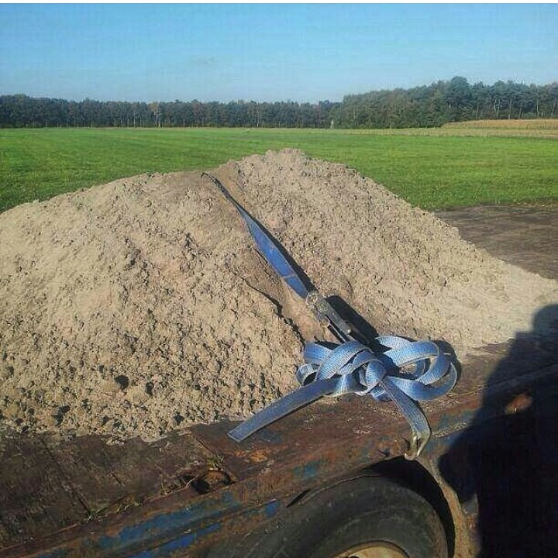
Method Critique
Here is where you explain if you have made some method choices that are not the very best. Sometimes we have to do that because of lack of time, money, resources, skills…and that is ok.
But remember to write here that you know you are doing it.
F.i. ”Quantitative research method theories stipulate (insert in-text reference) that I should have at least xx answers for my questionnaire, however, as I will have very little time to collect these answers I will aim for having at least 30 answers. While not ideal I beleave that 30 answers will be enough for me to form an opinion about…”

Slide 18
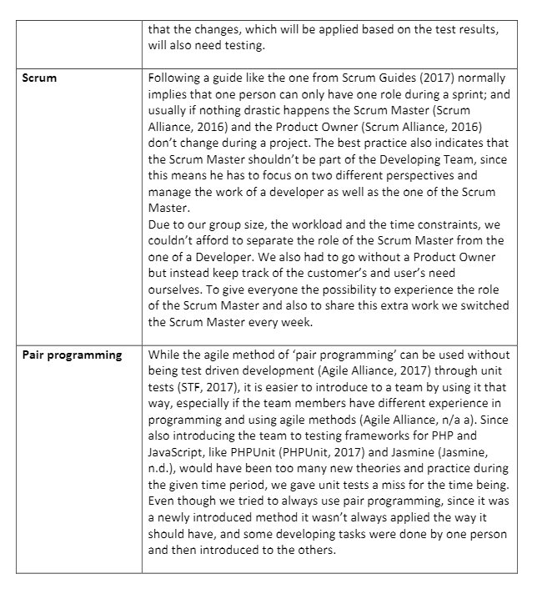
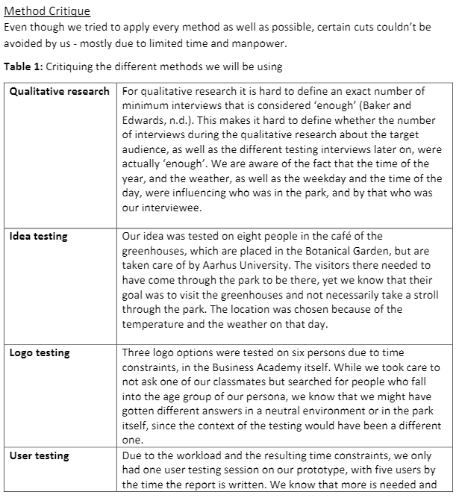
Example critique

Slide 19

Report structure: How to structure the report? (Road map)
You must describe content and aims of each chapter as well as the logic behind your choice of structure (order).
Helps the reader
Not necessary for short papers
4-10 lines or illustration (or both)

Slide 20
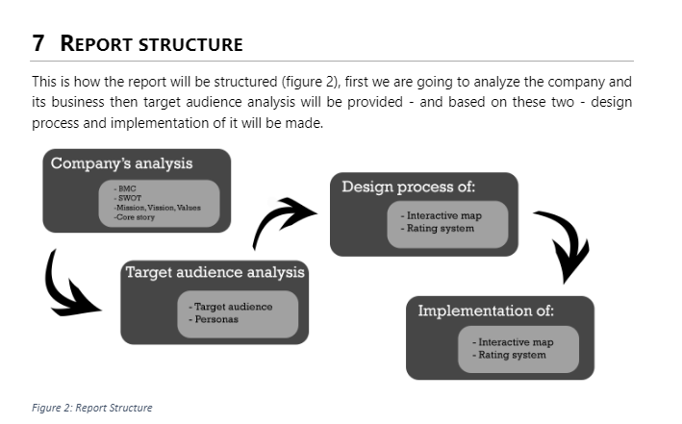
Examle report structure

Slide 21

Company presentation
Remember, your readers know nothing about the company!!!
Basic info about company is almost always relevant for understanding your report
F.I.
Financial situation
No of employees
Company structure
Discussion of competencies
Presentation of products
Where are they present
Partners
(You decide what is relevant!)
This can be placed elsewhere in the report but always before the analysis part!

Slide 22

Analysis
Descriptions, analyses, discussions, etc. REMEMBER to argue using what, why and how.
Remember to do it exactly like you said you would in your methodology
Each analysis/ element (I.e. swot)
Introduction: I am doing a swot analysis in order to establish… + reference to article/ book/ source
The actual SWOT
Conclusion: the most important things I learned from this SWOT analysis were: a…b…c.. These findings I am going to use later to create XX and to develop YY
Helps reader and helps you

Slide 23
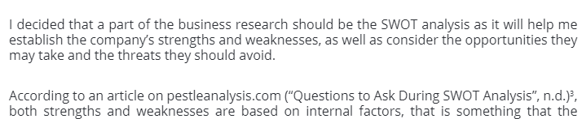
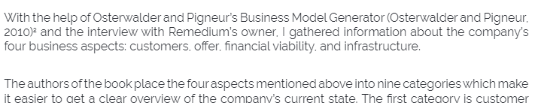
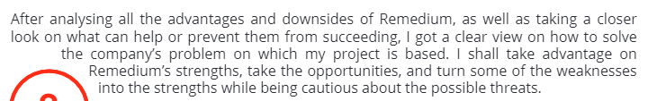
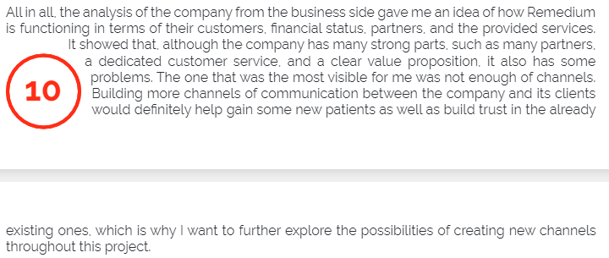
examples
intro
SWOT
Analysis
BMC
Outro – what can it be used for

Slide 24
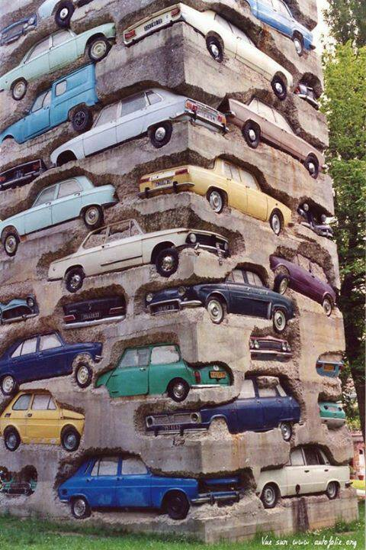
production
Remember to show your process and your thoughts not just final product
(Remember to use the new theory, if you have included such)
Remember to use the methods described in your methodology

Slide 25
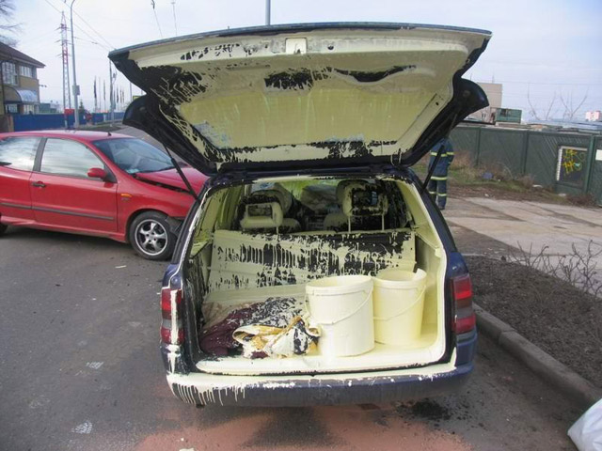
Discussion of how everything worked out…..
In this part you can reflect upon your own process, methods and results. This could be critical reflection and evaluation of
your chosen literature,
data collection,
tests and how it affects the reliability and validity of your conclusions.
It can also be a reflection of things you would like to change/ have done differently.
This is optional!

Slide 26

Conclusion: The project’s answer to the problem statement
This chapter must be written so that it can be read in direct continuation of the problem statement (which evaluators often do)
you should not include anything new,( this must wait until perspective).

Slide 27
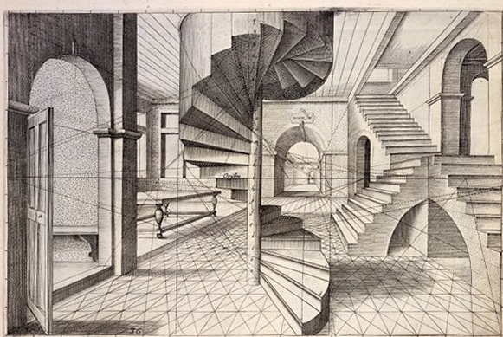

Perspective: putting the project’s results into perspective
relate the results to the problems you have mentioned in the introduction. By doing this, you will tie up your introductory and concluding chapters and close the ring, so to speak.
Opportunity to relate to something outside of your report

Slide 28
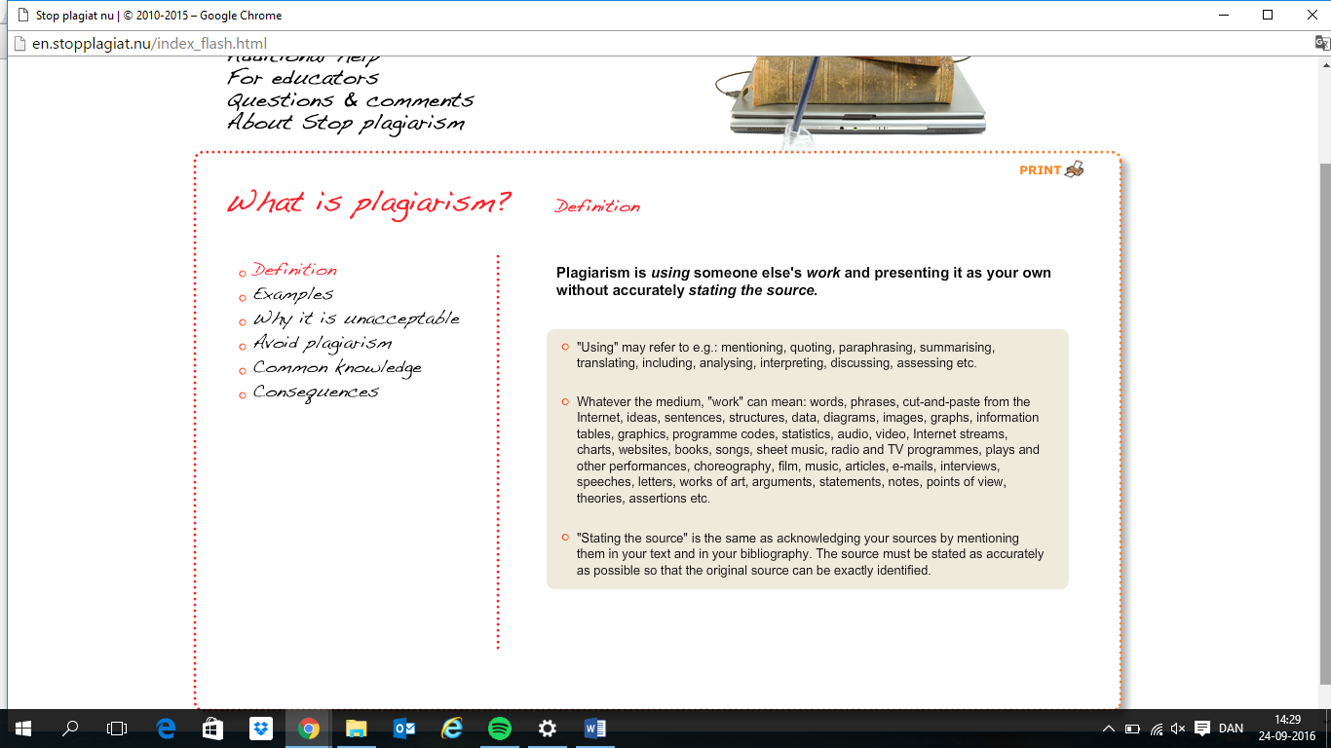
Remember plagiarism

Slide 29

Enjoy! And good luck…

